Slide 1
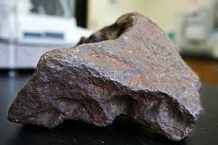
The $100,000 Doorstop
[1]
By: Thomas Fiorelli

Slide 2

Introduction:
“Money might not grow on trees, but it most certainly does fall from the sky”[2]
Every day bits of interplanetary material fall through Earth’s atmosphere
Most of this material burns up in the atmosphere and can be seen from Earth as “shooting stars”
It is estimated that 44,000 kg of meteoric material falls on the Earth every day

Slide 3
Background:
Meteorites are rarer than gold, platinum, diamonds and other precious metals, which actually makes them quite valuable
According to LiveScience, some can be worth as much as $1,000/gram and as low as $300/gram
That means the amount of material estimated to fall on the Earth everyday is estimated to be worth between:
$44 and 13.2 Billion

Slide 4
Reality Check:
Now of course, not all of this material survives the impact with the Earth’s atmosphere, and not much of it is really impacting the surface where it can be discovered or collected
However!
The Meteoritical Society maintains an extensive database of meteor impacts and some data surrounding the finds

Slide 5
Quick Summary Stats:
After cleaning up this database and organizing for analysis, we find immediately:
There are 38,100 records for meteorites discovered between the year 1688 and 2013
These meteorites make up about 534,207,314.44 grams worth of material
This material is estimated to be worth between:
$534 & 160 Billion

Slide 6
Project Description:
So what can we do with all this information?
Most people who are just hoping to catch sight of a shooting star or a meteor shower don’t have the time or skillset for in depth research, and even scientists or treasure hunters looking for meteorite landings could benefit from easier access to such information
What if there was a platform that made it easy for any user, recreational, scientific or otherwise, to quickly research activity in their area. This would allow for people to plan events like coordinating hikes and outings, and could help scientists and meteorite hunters find the ones that hit the Earth.
It would be great to see an app of some form that could give recommendations on predicted upcoming events in the area and provide historical data on activity at the user’s location.

Slide 7
Results:
Starting with the database from The Meteoritical Society
I drop any incomplete entries (mass / location is missing)
I simplify the discovery date down to just the Year for ease of comparison
I define a Location class for any location given a latitude and longitude
And a Meteorite subclass which will store a location as well as information specific to the meteorites themselves
All existing records are read into the new database and some functions defined to:
Initialize the database with existing data
Populate new records as they are discovered
Calculate the distance between records
Estimate the monetary value of the meteorite object
Get the user’s location

Slide 8
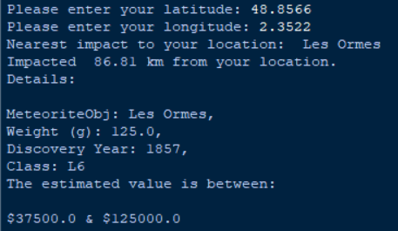
Example 1: Using Paris, France

Slide 9
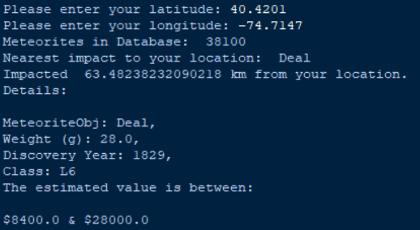
Example 2: Using New Brunswick, NJ, USA

Slide 10
These examples can also be confirmed by searching!
Les Ormes Meteorite, impacted in France:
https://www.lpi.usra.edu/meteor/metbull.php?code=12769
Deal Meteorite, impacted in Monmouth County, NJ !
https://www.lpi.usra.edu/meteor/metbull.php?code=6634

Slide 11
Limitations on Scope:
I wanted to be able to read the user’s location from a device if this were a real app- the userLocation() function takes input from the user at the moment, but could be upgraded to get this information directly from the device
Here I look at 1 primary use case of the “app” which is to take the user’s location, and provide details on the meteorite impact nearest their location, including an estimated value of the specimen
In a grander project scope, we could build an interactive dashboard with Dashly that could add functionality for plotting these coordinates and filtering on mass / class / discovery year/ location which are all available in the class created

Slide 12
3rd Party Libraries used
Pandas as pd
Math
My custom Meteorite_Lib

Slide 13
Links and References:
Data Source:
https://data.nasa.gov/Space-Science/Meteorite-Landings/gh4g-9sfh
http://solarsystem.nasa.gov/planets/meteors/indepth
https://www.lpi.usra.edu/meteor/
References: [1] http://time.com/5416853/meteorite-in-michigan/ [2] https://bgr.com/2018/02/15/meteorite-auction-christies-canyon-diablo-meteorite/

